Slide 1
Reading Text Files
File.ReadAllText() → string – reads a text file at once
File.ReadAllLines() → string[] – reads a text file's lines
using System.IO;
…
string text = File.ReadAllText("file.txt");
using System.IO;
…
string[] lines = File.ReadAllLines("file.txt");

Slide 2
Writing Text Files
Writing a string to a text file:
Writing a sequence of strings to a text file, at separate lines:
Appending additional text to an existing file:
File.WriteAllText("output.txt", "Files are fun :)");
string[] names = {"peter", "irina", "george", "maria"};
File.WriteAllLines("output.txt", names);
File.AppendAllText("output.txt", "\nMore text\n");

Slide 3
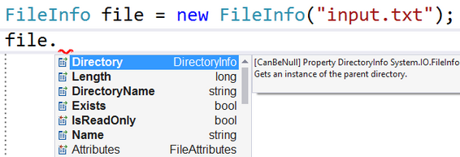
Inspecting Files
Use FileInfo to get information about a file:
var info = new FileInfo("output.txt");
Console.WriteLine("File size: {0} bytes", info.Length);
Console.WriteLine("Created at: {0}", info.CreationTime);
Console.WriteLine("Path + name: {0}", info.FullName);
Console.WriteLine("File extension: {0}", info.Extension);

Slide 4
Problem: Odd Lines
Write a program to read a text file lines.txt and extract its odd lines (starting from 0) in a text file odd-lines.txt
File.ReadAllLines(…) method opens a text file,
reads all lines of the file, and then closes the file.
This method attempts to automatically detect the encoding
of a file based on the presence of byte order marks.
Encoding formats UTF-8 and UTF-32 (both big-endian and
little-endian) can be detected.
reads all lines of the file, and then closes the file.
of a file based on the presence of byte order marks.
little-endian) can be detected.

Slide 5
Solution: Odd Lines
string[] lines = File.ReadAllLines("lines.txt");
File.Delete("odd-lines.txt");
for (int i = 1; i < lines.Length; i += 2)
File.AppendAllText("odd-lines.txt",
lines[i] + Environment.NewLine);
A better solution:
string[] lines = File.ReadAllLines("lines.txt");
var oddLines = lines.Where((line, index) => index % 2 == 1);
File.WriteAllLines("odd-lines.txt", oddLines);

Slide 6
Problem: Insert Line Numbers
Read a text file input.txt line by line
Insert line numbers in front of each line (start by 1)
Write the result in a text file output.txt
first line
second line
third line
fourth line
fifth line
1. first line
2. second line
3. third line
4. fourth line
5. fifth line

Slide 7
Solution: Line Numbers
string[] lines = File.ReadAllLines("input.txt");
var numberedLines = lines.Select(
(line, index) => $"{index+1}. {line}");
File.WriteAllLines("output.txt", numberedLines);

Slide 8
Problem: Word Count
Read a list of words from words.txt and find how many times each word occurs (as case-insensitive) in a text file text.txt
Write the results in results.txt
Sort the words by frequency in descending order
-I was quick to judge him, but it wasn't his fault.
-Is this some kind of joke?! Is it?
-Quick, hide here…It is safer.
text.txt
is -> 3
quick -> 2
fault -> 1
quick is fault
words.txt
results.txt

Slide 9
Solution: Word Count
string[] words =
File.ReadAllText("words.txt").ToLower().Split();
string[] text = File.ReadAllText("input.txt").ToLower()
.Split(new char[] {'\n','\r',' ', '.', ',', '!', '?', '-'},
StringSplitOptions.RemoveEmptyEntries);
var wordCount = new Dictionary<string, int>();
foreach (string word in words)
wordCount[word] = 0;
foreach (string word in text)
if (wordCount.ContainsKey(word))
wordCount[word]++;
// Write the output (sorted) to a text file "results.txt"

Slide 10
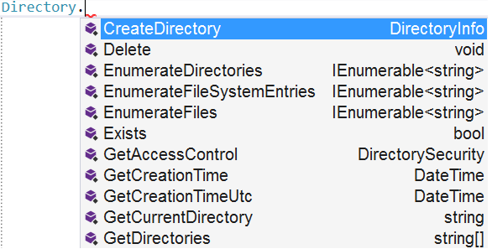


Directory Class in .NET
.NET API for Working with Directories

Slide 11
Basic Directory Operations
Creating a directory (with all its subdirectories at the specified path), unless they already exists:
Deleting a directory (with its contents):
Moving a file or directory to a new location:
Directory.CreateDirectory("TestFolder");
Directory.Delete("TestFolder", true);
Directory.Move("Test", "New Folder");

Slide 12
Listing Directory Contents
GetFiles() – returns the names of files (including their paths) in the specified directory
GetDirectories() – returns the names of subdirectories (including their paths) in the specified directory
string[] filesInDir =
Directory.GetFiles("TestFolder");
string[] subDirs =
Directory.GetDirectories("TestFolder");

Slide 13
Problem: Calculate Folder Size
You are given a folder named TestFolder
Calculate the size of all files in the folder (without subfolders)
Print the result in a file output.txt" in Megabytes
output.txt
5.16173839569092

Slide 14
Solution: Calculate Folder Size
string[] files = Directory.GetFiles("TestFolder");
double sum = 0;
foreach (string file in files)
{
FileInfo fileInfo = new FileInfo(file);
sum += fileInfo.Length;
}
sum = sum / 1024 / 1024;
File.WriteAllText("оutput.txt", sum.ToString());

Slide 15

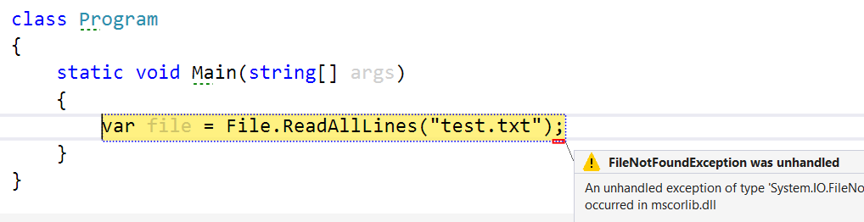
Exceptions
Signaling about and Handling Runtime Errors

Slide 16
What are Exceptions?
Exceptions are a powerful mechanism for centralized handling of errors and unusual events
Raised at runtime, when a problem occurs
Can be caught and handled

Slide 17
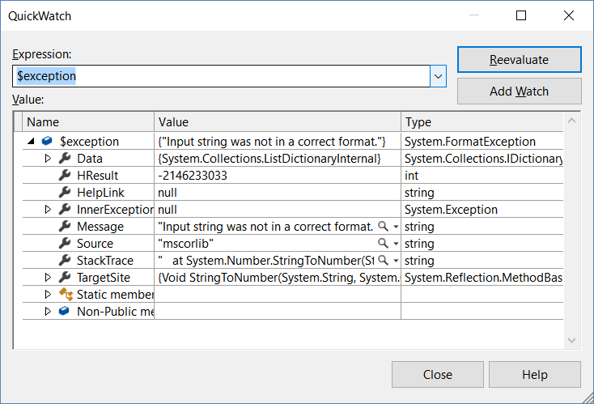
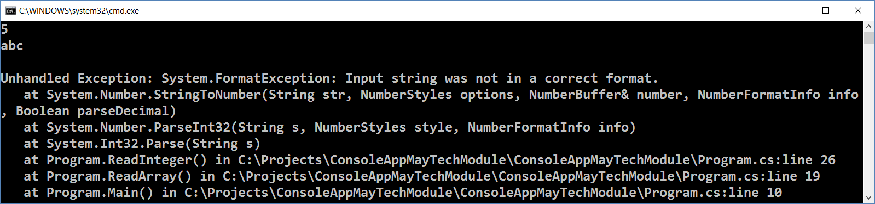
The System.Exception Class
The System.Exception class is base for all exceptions in .NET
Holds information about the problem
Message – problem description (text)
StackTrace –snapshot of the stack

Slide 18
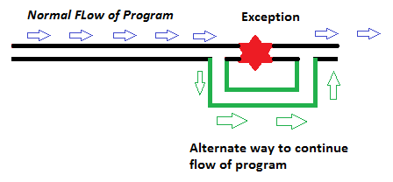

Handling Exceptions

Slide 19
The try-catch Statement
Catching exceptions:
try
{
// Do some work that can cause an exception
}
catch
{
// This block will execute if any type of exception occurs
}

Slide 20
The try-catch Statement (2)
Catching a certain exception types only:
try
{
// Do some work that can cause an exception
}
catch (FormatException formatException)
{
// This block will execute only if format exception occurs
}

Slide 21
The try-finally Statement
Ensures execution of given block in all cases
When exception is raised or not in the try block
Used for execution of cleaning-up code, e.g. releasing resources
try
{
// Do some work that can cause an exception
}
finally
{
// This block will always execute
}

Slide 22
The try-catch-finally Statement
try
{
// Do some work that can cause an exception
}
catch(FileNotFoundException fileNotFoundEx)
{
// This block will be executed only if
// "file not found" exception occurs
}
finally
{
// This block will always execute
}

Slide 23


Summary
Use the File class to work with files
Create / modify / read / write / delete files
Use the Directory class to work with directories
Create / delete directories / list files / folders
Exceptions provide error handling mechanism
Hold information about a runtime error
Can be caught and handled
try-catch

Slide 24







Files, Directories and Exceptions
https://softuni.bg/courses/programming-fundamentals

Slide 25

License
This course (slides, examples, demos, videos, homework, etc.) is licensed under the "Creative Commons Attribution-NonCommercial-ShareAlike 4.0 International" license
Attribution: this work may contain portions from
"Fundamentals of Computer Programming with C#" book by Svetlin Nakov & Co. under CC-BY-SA license

Slide 26





Trainings @ Software University
Software University – High-Quality Education, Profession and Job for Software Developers
softuni.bg
Software University Foundation
softuni.org
Software University @ Facebook
facebook.com/SoftwareUniversity
Software University Forums – forum.softuni.bg

